Slide 1

Failing Happily
Secret Sauce Of Agility

Slide 2
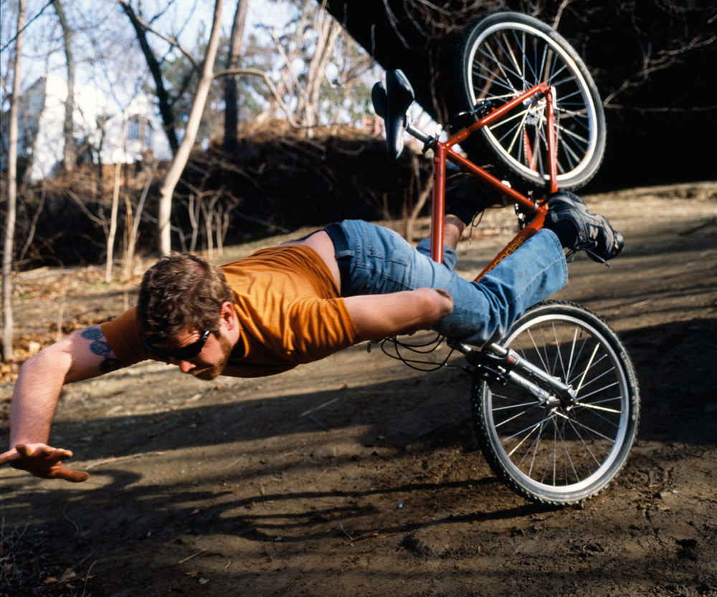
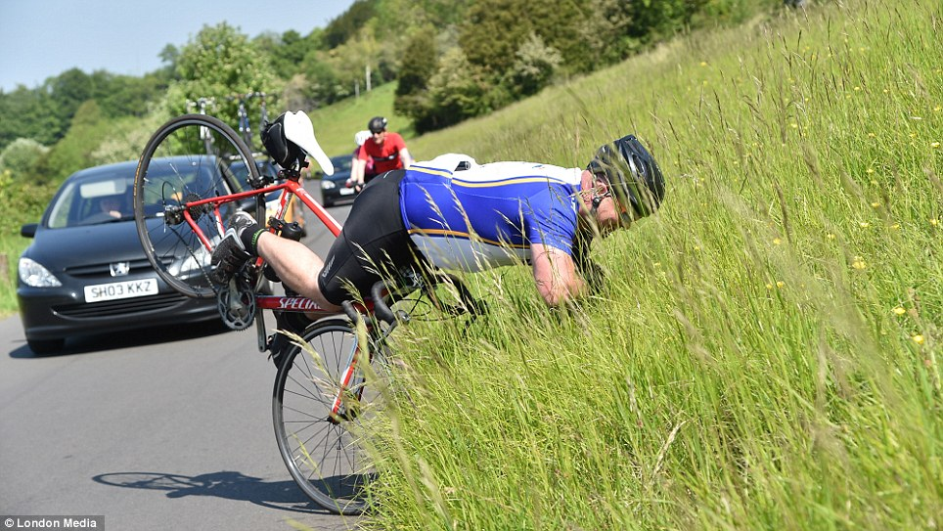
Difference ?

Slide 3

KATA 1 Solve An UnKnOWN PROBLEM

Slide 4
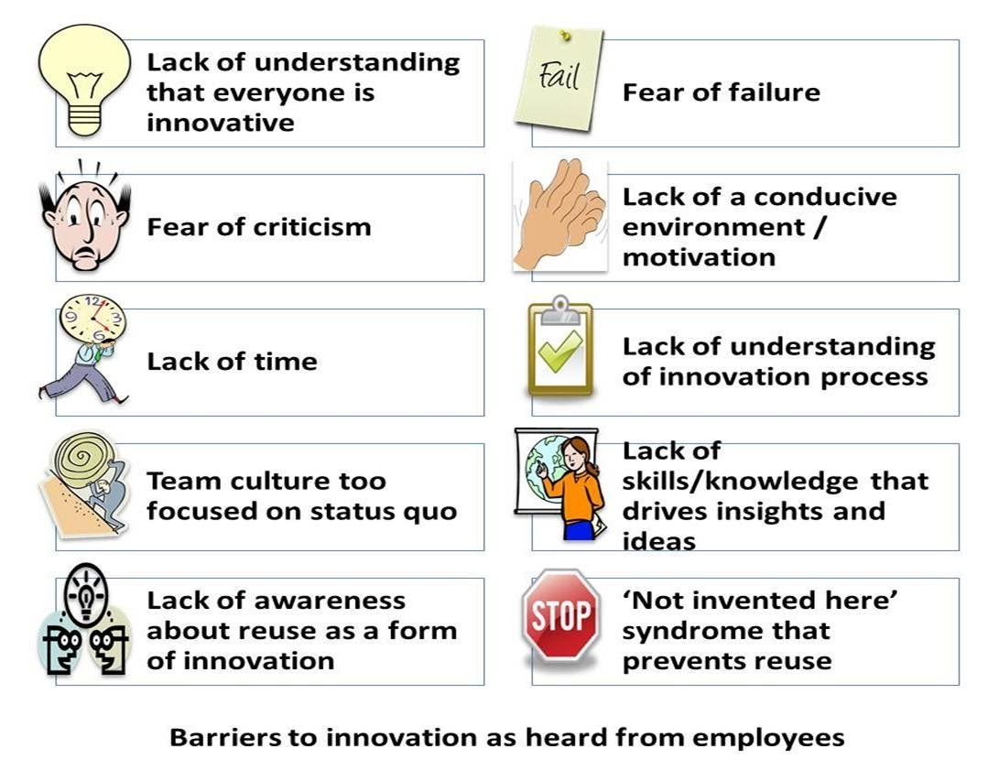
Blockers To ACTION

Slide 5
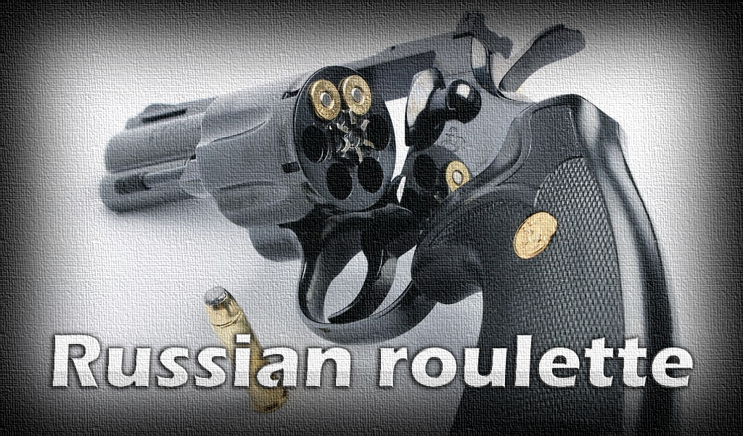

It is hard to take action

Slide 6




















It is hard to take action

Slide 7
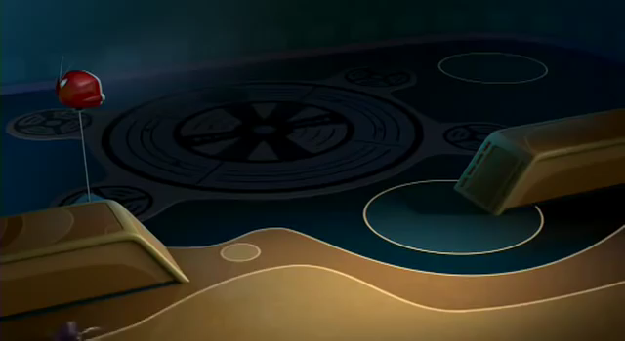
FAILING HAPPILY

Slide 8

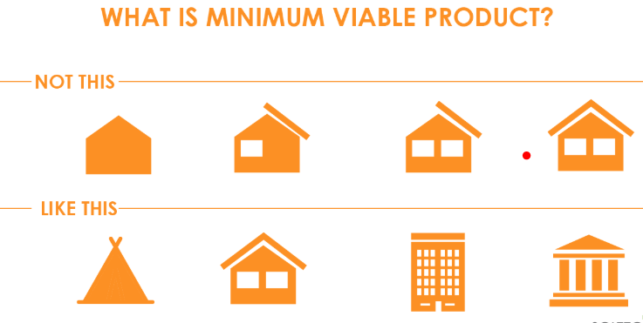










Making A MVP
Happy Bullocks
Traffic Lights

Slide 9
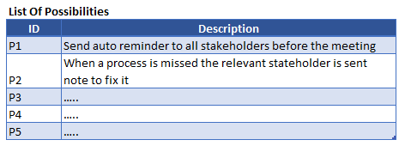
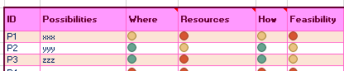
Possibility Filter
Skills / People / Money / Time
Physical Location / Biz Area / Module / Process
Clarity of implementation / Decomposable

Slide 10
Real life scenario – Generate Possiblities
A mobile browser based application like Magiqspark.com which is production for 4 years.
The application has 30 complex features / 30 medium complexity features / 40 simple features
There is a new customer who has expressed interest if it was a native mobile application
There 2 Full time developers but have no mobile application experience
One part time native mobile developer who can spend 10 hours per week
Objective – Design MVP 1
Generate Possibilities
Duration of MVP to production in 2 weeks
Apply Traffic Light Method Fractal

Slide 11
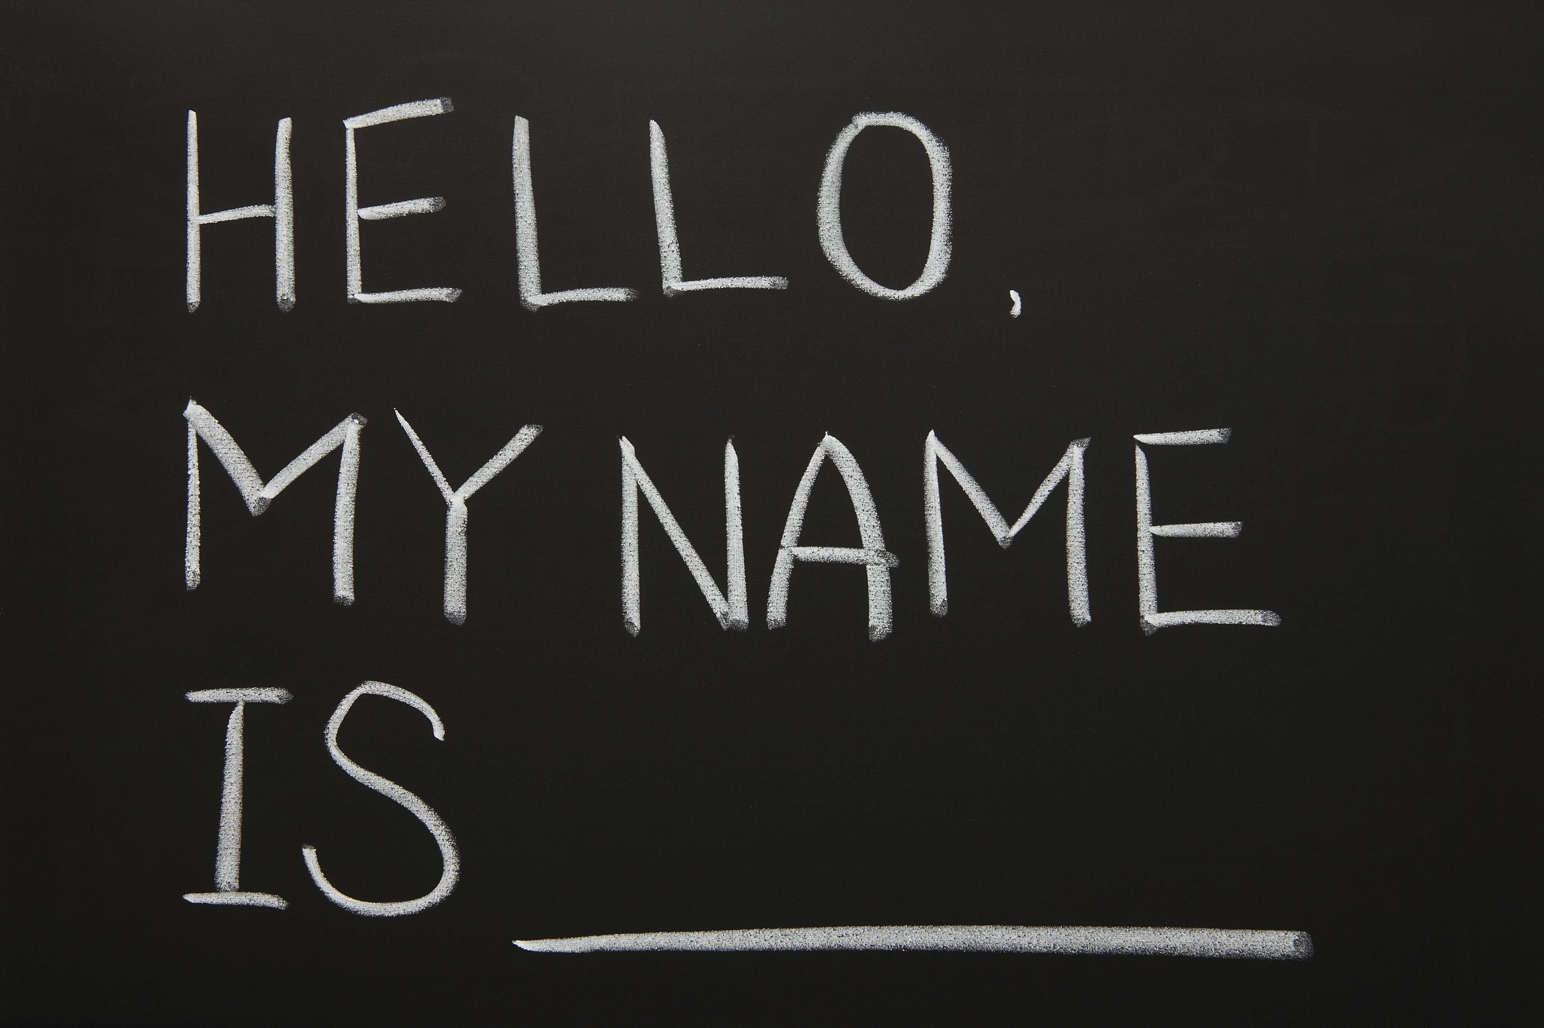
KATA 2 FIND MY NAME

Slide 12
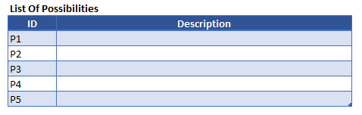
KATA Identify MVP

Slide 13
2 MVP Scenarios - Kata
Home
Work
The ODC had many security and network restrictions which stops us from doing any state of art work. We are tired of trying for 2 years now.
Lastly data security is used as the final weapon
The banking customer has legacy applications but does not give us permission to try new technologies.
The neighbor has been playing loud music.
Even after repeated attempts to explain and requesting for many months there is no change.
Extremely angry

Slide 14
Theme – PUC Mapping
How my MVP is helping the Organization
Theme : ( Give your initiative title here )
PUC 1
Total Revenue : ( Give projected revenue)
Describe the PUC.
Describe the potential savings in effort or cost of addressing this PUC by the current MVP.
Total Cost : ( Give cost savings)
Factors For Above
Point 1
Point 2
PUC 2
Describe the PUC.
Describe the potential savings in effort or cost of addressing this PUC by the current MVP.
PUC 3
Describe the PUC.
Describe the potential savings in effort or cost of addressing this PUC by the current MVP.
PUC 3
Describe the PUC.
Describe the potential savings in effort or cost of addressing this PUC by the current MVP.

Slide 15
Extreme Objective Roadmap
MVP1
Description
Actual Result
MVP 2
Description
Expected Result
MVP 3
MVP 5
Description
Expected Result
MVP 4
Description
Expected Result
Description
Expected Result

Slide 16
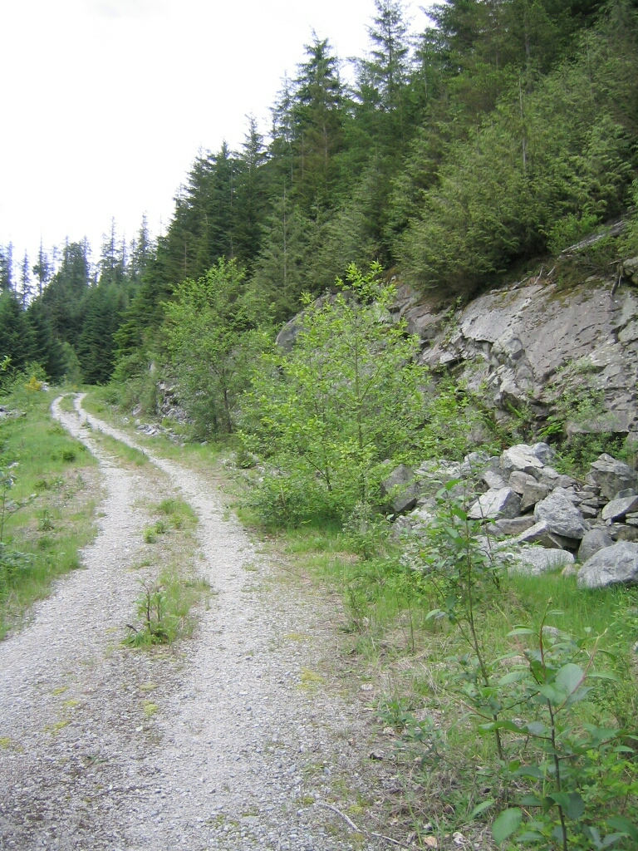
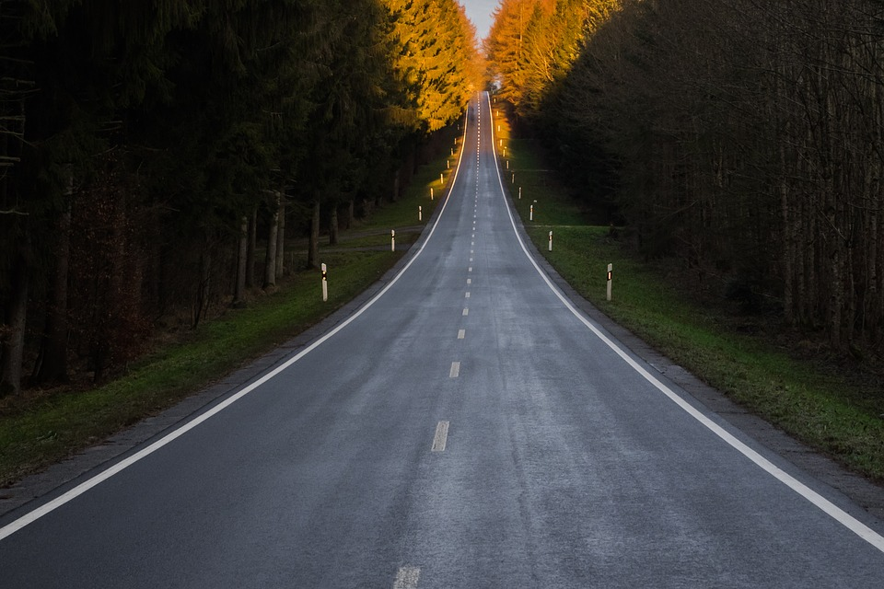

Which Path Will You Take

Slide 17
But it is hard to “Live Intentions” ?
Tiny Demon
Meet it
Slay It

Slide 18

Build It

Slide 19
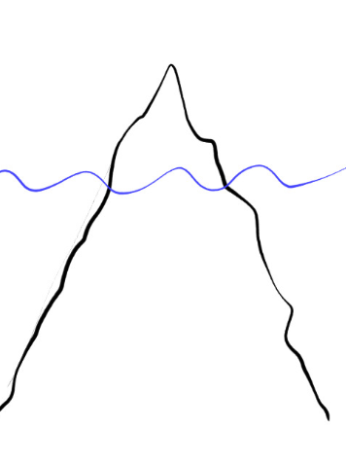

HiPoHa – High Performance Happily Achieved
HiPoHa Framework
Overview
Iceberg
Tip
PROBLEM
Ship Hits Iceberg
SOLUTION
Action Oriented Mindset
Bottom
Intention Oriented Mindset
Fractal Routines**
(Patent Pending)
3.Performance Undersupply X-Ray
Transformative
Mindset Fractals
Method Fractals
1.Identify Customer Intentions
4.Zoom in Pivot/Zoom Out Pivot
[Extreme Pivot]
Mindset & Method Anti
Fractals
Analyze
Result
2.Customer Journey Mapping
5.Generate Possibilities [Future
Making]
6.MVP Loop
Intention Orientation
CQA
Traffic Light Model
Happy
Bullocks
Tiny Grit
Tiny Demon

Slide 20

Traffic Light – part 1
People
Possibilities
% Time Spent ??

Slide 21
Traffic Light – part 2
Rest of the World
Exercise?
Work?
Circle of Influence
Traffic?
Circle of Control
Hunger?
Present?
Past?
Citation: Stephen Covey’s 7 habits of effective leaders. JB Rotter’s Locus of Control

Slide 22
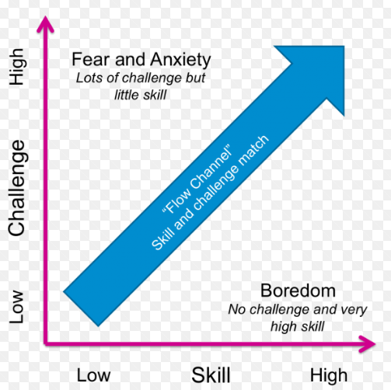

Happy bullocks
Happy Path

Slide 23
Problems – MVP ( 1 Week )
Publish an app using Native Script on Apple Store
Develop Device Driver For Windows 10
Do a PHD in Artificial Intelligence
Close a 1 Million $ Deal

Slide 24

Rally The HERD

Slide 25
DOJO DESIGN
Where ?
When ?
What ?

Slide 26

KATA 3 DoJO Design CHECKIN

Slide 27

Be
Happily Dissatisfied

